Slide 1
Interpreter Design and Implementation
RAJARSHI BHATTACHARYA
MSC COMPUTER SCIENCE
ST. XAVIER’S COLLEGE

Slide 2
What is an interpreter
An interpreter is just a program. As input, it takes a specification of a program in some language. As output, it produces the output of the input program. It translates code like a compiler but reads the code and immediately executes on that code, and therefore is initially faster than a compiler.
Interpreters were used as early as 1952 to ease programming within the limitations of computers at the time (e.g., a shortage of program storage space, or no native support for floating point numbers). Interpreters were also used to translate between low-level machine languages, allowing code to be written for machines that were still under construction and tested on computers that already existed. The first interpreted high-level language was Lisp, which was first implemented in 1958 by Steve Russel on an IBM 704 computer.

Slide 3
Interpreter vs Compiler
Compiler transforms code written in a high-level programming language into the machine code, at once, before program runs, whereas an Interpreter coverts each high-level program statement, one by one, into the machine code, during program run.
Compiler displays all errors after compilation, on the other hand, the Interpreter displays errors of each line one by one.
Compiler takes an entire program whereas the Interpreter takes a single line of code.

Slide 4
Types of interpreters
Bytecode interpreters: In these types of interpreters, source code is compiled to bytecode, which is a highly compressed and optimized representation of the source but, it is not machine code and therefore not tied to any hardware. This "compiled" code is then interpreted by a bytecode interpreter. The compiled code in this case is machine code for a virtual machine, which is implemented not in hardware, but in the bytecode interpreter. Such compiling interpreters are sometimes also called compreters. e.g., Lisp

Slide 5
Types of interpreters(Cont.)
Threaded code interpreters: Threaded code interpreters are similar as bytecode interpreters but instead of bytes they use pointers. Each "instruction" is a word that points to a function or an instruction sequence, possibly followed by a parameter. The threaded code interpreter either loops fetching instructions and calling the functions they point to, or fetches the first instruction and jumps to it, and every instruction sequence ends with a fetch and jump to the next instruction. Unlike bytecode there is no effective limit on the number of different instructions other than available memory and address space. e.g., Forth code used in Open Firmware systems: here, the source language is compiled into "F code" (a bytecode), which is then interpreted by a virtual machine.

Slide 6
Types of interpreters(cont.)
Abstract Syntax Tree(AST) interpreters: In case of AST interpreters, Source code is converted to an Abstract Syntax Tree, which is a tree representation of the abstract syntactic structure of source code written in a programming language, where each node denotes a construct occurring in the source code. This AST is then interpreted by an AST interpreter.
Just-in-time compilers(hybrid compiler): Just-in-time compilation is a technique in which the intermediate representation is compiled to native machine code at runtime. This confers the efficiency of running native code, at the cost of startup time and increased memory use when the bytecode or AST is first compiled.

Slide 7
Implementation of An ast interpreter
The interpretation process can mainly be divided into 3 functional increments. The increments are:
Scanning or tokenizing: Scanning, lexical analysis or tokenization is the process of converting a sequence of characters into a sequence of tokens (strings with an assigned and thus identified meaning).
Parsing(which is basically forming the AST): Parsing includes taking input data (frequently text) and building a data structure(which is AST here) giving a structural representation of the input while checking for correct syntax. The parsing may be preceded or followed by other steps, or these may be combined into a single step.

Slide 8
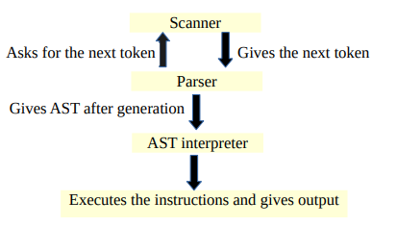
Implementation of An ast interpreter
Interpreting the AST: This includes, interpreting the AST by visiting the nodes and executing the instructions provided.
Before moving to the next increment, the current increment has to be tested and validated.
Figure-1: Design of a basic AST interpreter

Slide 9
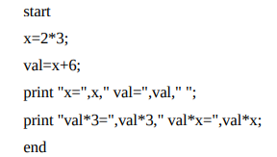
Design of the interpreter(CONT.)
Rules for the new language:
Every program must start with a “start” keyword and end with “end” keyword and in between these two keywords the main body of the program must take place.
The body of the program will contain list of statements which can be either a print statement or declaration of variables and every statement must end with a semicolon.
Only int type variables are supported.
Figure 2: Example of a program of the new language

Slide 10
Design of the interpreter(CONT.)
Multiple declarations of variables in a single line is not allowed.
The print statement may contain a string or a variable which is declared before or an expression or a string with an expression or variable. Each of these must be separated by comma.
The newlines and spaces will be ignored except for print keyword where, there must be a space after the print keyword and the contents to be printed.

Slide 11
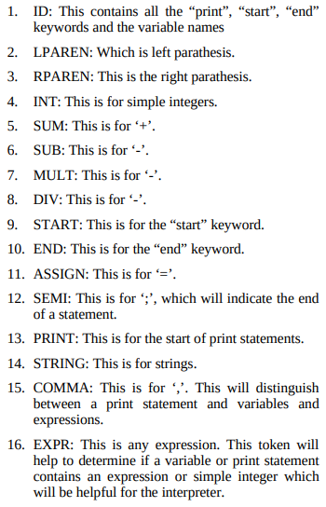
Design of the scanner
Based on the rules stated above the scanner can be designed to tokenize the whole program into the following tokens: ID, LPAREN, RPAREN, INT, SUM, SUB, MULT, DIV, START, END, ASSIGN, SEMI, PRINT, STRING, COMMA, EXPR etc.
This tokenization can either be done by feeding the whole program to the scanner as a string or stream of characters and it will be converted to a stream of tokens or the parser asks the scanner for tokens for each increment of the position in the stream of characters or in the input string.
Figure 3: Tokens of the new language

Slide 12
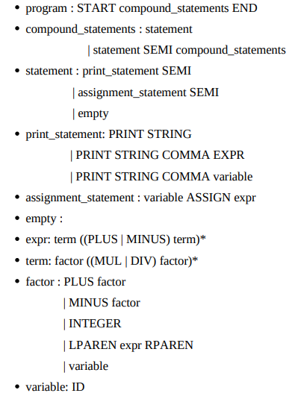
Design of the parser
So, if as the rule stated before the grammar can be designed accordingly, like Figure-3.
Here, the parser will ask the scanner for tokens for each increment of the position in the stream of characters or in the input string.
Figure-3: Grammar for the new language

Slide 13
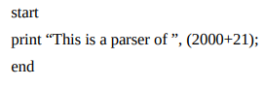
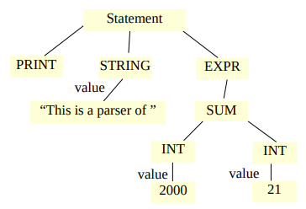
Design of the parser(CONT.)
If we consider, a program like Figure-4, then after feeding the program to the parser, it should give the Abstract Syntax Tree like Figure-5, which can further be interpreted by the AST interpreter.
Figure-4: A program of the new program
Figure-5: AST for the program above

Slide 14
Design of the AST Interpreter
The work can be categorized in the following aspects,
Maintaining a Symbol Table.
Visiting each node of the AST.
Executing the instructions of the node.
Symbol Table: The parser of a compiler or an interpreter builds and maintains a symbol table throughout the translation process as part of semantic analysis. The symbol table stores information about the source program’s tokens, mostly the identifiers. The symbol table is a key component in the interface between the front and back end.

Slide 15
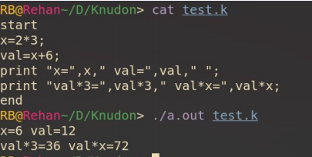
Design of the AST Interpreter(CONT.)
Here, the symbol table will contain the name of the identifier and the integer value of the identifier as only integer values are supported in this new language.
Visiting and Executing the nodes: The execution of the AST instructions can be easily be done by simply going through the nodes by an in-order traversal and execute accordingly. For example, if the interpreter finds a print node it will then print the string or identifier, or expression given in the next node. An example of the execution of the program given in Figure-1 is shown in Figure-6
Figure-6: Executed program of the new language

Slide 16
Future Works
Future work will focus on creating a complete programming language interpreter that can perform all basic operations as a programming language.
Object-oriented paradigms can also be included for the language.
An interactive source-level debugger for the new language that enables the use of command lines to interact with the interpreter as well as an Integrated Development Environment (IDE) with a graphical user interface (GUI) can also be designed.
If time is not a constraint, the interpreter can be extended to a compiler that generates object code for a Virtual Machine (VM). Then the compiled programs will be able to run on multiple platforms.

Slide 17
REFERENCES
Fan Wu, Hira Narang, Miguel Cabral, “Design and Implementation of an Interpreter Using Software Engineering Concepts”, (IJACSA) International Journal of Advanced Computer Science and Applications, Vol. 5, No. 7,2014
Alfred Aho and Jeffrey Ullman, “Principles of Compiler Design”, 1977
https://en.wikipedia.org/wiki/Interpreter_(computing)
Faisal Chughtai, “Compiler and Interpreter”

Slide 18
THANK YOU

